Slide 1




Organization : Entrepreneurship Development AndInnovationInstitute
( EDII-TN ) andTamilNadu Skill Development Corporation
Problem Statement : To Develope a Decentralized Database for HealthCare
by using Machine Learning and Blockchain Technology
Team Name : Medico Mavericks
Team Leader : Naveenkumar Arumugam
Institution code : 8224
Institution Name : MRK Institute of Technology

Slide 2





Meet myTeam
Naveenkumar
Akash
Abdur Rahman

Slide 3




PROBLEM
STATEMENT
The current healthcare system faces significant challenges in data security, emergency response efficiency, and patient record management. Frequent data breaches compromise sensitive patient information, undermining trust in healthcare providers. Additionally, delays in emergency medical responses due to inefficient communication systems can endanger lives.

Slide 4

OBJECTIVES
To develop a secure and decentralized healthcare management system utilizing blockchain technology enabling doctors to securely upload and manage patient records, implement a location-based alert system for timely emergency notifications near government hospitals and ambulances, and ensure data integrity and accessibility. This project focusing on security, decentralization, and enhancing healthcare service delivery through technology.

Slide 5
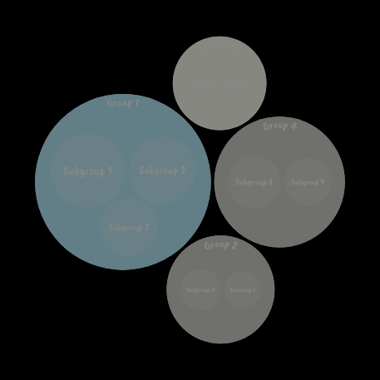

ABSTRACT
Project Planning and Requirements Gathering
System Design
UI/UX Development
Location-Based Alert System
Frontend Development
Blockchain Integration (Future Phase)
Backend Development
Testing and Quality Assurance
Deployment and Maintenance

Slide 6


INNOVATION (VISION)
1. Secure Healthcare Data Managemen t: Utilize blockchain technology to establish a secure and transparent platform for storing and managing healthcare data.
2. Empower Doctors : Enable doctors to securely upload, access, and update patient records with ease and confidence.
3. Enhanced Patient Care : Implement a robust location-based alert system near government hospitals and ambulances to ensure rapid response times for emergencies.
4. Optimized Healthcare Delivery : Improve operational efficiency by streamlining data access
5. Setting New Standards : Set new benchmarks in healthcare management by integrating cutting-edge technology to deliver safer, more efficient.

Slide 7



ISSUES IN THE TRADITIONAL MEDICAL SYSTEM
Data Privacy and Security
Issue: Frequent data breaches and unauthorized access.
Emergency Response
Issue: Delayed emergency response times.
Data Accuracy and Integrity
Issue: Inaccurate or incomplete medical records.

Slide 8

Patient Engagement and Accessibility
Issue: Difficulty in accessing medical records.
Administrative Burden
Issue: Heavy load on hospital administrators.
Fragmented Patient Records
Issue: Patient records scattered across different providers.

Slide 9

HOW OUR PROJECT OVERTCOME THESE ISSUES
Enhanced Security: The use of blockchain technology ensures that patient data is secure, tamper-proof, and only accessible to authorized individuals.
Improved Interoperability: The centralized database facilitates data sharing among different healthcare providers, and the eventual transition to blockchain ensures that this data remains secure and accessible.
Real-time Emergency Alerts: The location tracker enhances emergency response times by providing real-time alerts within a 10km radius of a government hospital or ambulance.
Accurate and Up-to-date Records: Doctors are responsible for uploading patient records directly, ensuring the data is accurate and current.

Slide 10

Patient Empowerment: Patients have easy access to their medical records and treatment plans, allowing them to take an active role in their healthcare.
Streamlined Administration: The system reduces the administrative burden on hospital staff by centralizing data management and ensuring compliance with regulations.
Unified Patient Records: Consolidating patient records into a single database ensures that healthcare providers have a complete view of a patient’s medical history, leading to better-informed treatment decisions.

Slide 11
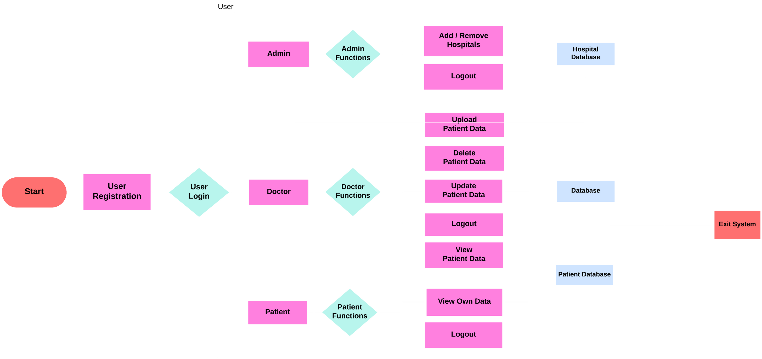
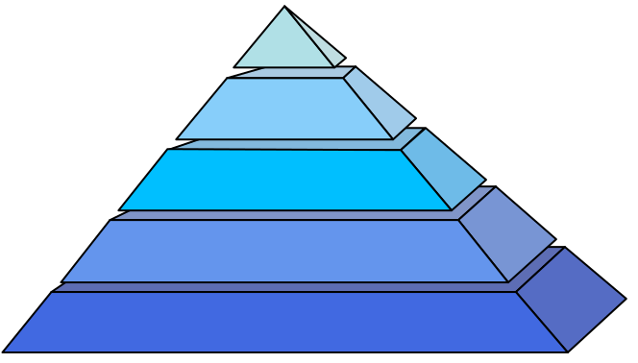
Work Flow

Slide 12

Project Idea: Emergency Tracker System for Rural Areas
Emergency Alert Button: A single button on the web application that users can click in case of an emergency.
User Input Form: Upon clicking the button, users are prompted to enter the patient's phone number, location, type of emergency, and patient name.
Location Tracking: The application uses GPS to determine the user's location and searches for available ambulances or government hospitals within a 10 to 15 km range.
Database Management: Maintains a database with hospital details, locations, and ambulance GPS locations with driver contact numbers.
Alert System: Sends emergency alerts to the nearest available ambulance or hospital, providing all necessary details to ensure prompt response.
Implementation Steps

Slide 13
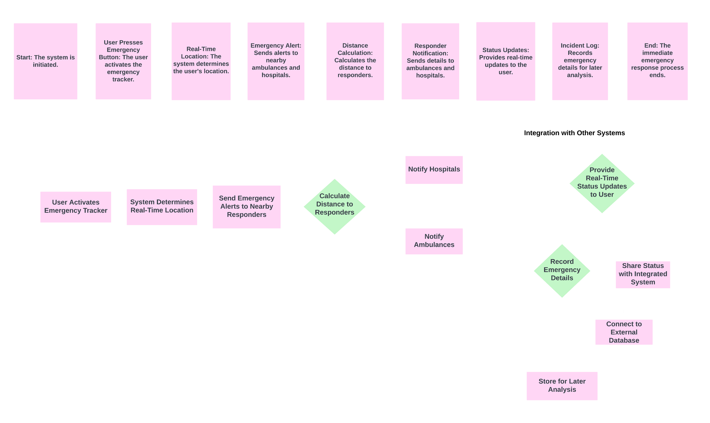
Work Flow for
emergency tracker

Slide 14

Technical Stack
FRONTEND
Framework : React.js or Vue.js
BLOCKCHAIN
(FUTURE TECHNOLOGY)
Platform : Ethereum
Integration : WEB3.JS for smart contract interaction
BACKEND
Language/Framework: Python (Flask or Django) Database: MongoDB (flexible document storage)
CLOIUD
(FUTURE TECHNOLOGY)
Cloud Provider: AWS, Google Cloud Platform, or Azure

Slide 15

BENEFITS
Enhanced Security
Improved Efficiency
Timely Emergency Response
Patient-Centric Care
Innovation and Future-Readiness

Slide 16


CONCLUSION
Our project addresses critical challenges in the healthcare sector by enhancing data security, improving emergency response times, and streamlining patient record management. By leveraging blockchain technology, real-time location-based alerts, and a robust tech stack, we aim to create a secure, efficient, and future-ready healthcare management system.

Slide 17




